Slide 1
Lab 6 – CollectionView + Database
Mr. Yousif Garabet Arshak
Computer Science Department
University of Zakho
yousif.arshak@uoz.edu.krd

Slide 2
Outlines
CollectionView
Text File
SQLite

Slide 3
CollectionView Introduction
CollectionView is a view for presenting lists of data using different layout specifications. It aims to provide a more flexible, and performant alternative to ListView.

Slide 4
CollectionView and ListView differences
While the CollectionView and ListView APIs are similar, there are some notable differences:
CollectionView has a flexible layout model, which allows data to be presented vertically or horizontally, in a list or a grid.
CollectionView supports single and multiple selection.
CollectionView has no concept of cells. Instead, a data template is used to define the appearance of each item of data in the list.
CollectionView automatically utilizes the virtualization provided by the underlying native controls.
CollectionView reduces the API surface of ListView. Many properties and events from ListView are not present in CollectionView.
CollectionView does not include built-in separators.
CollectionView will throw an exception if its ItemsSource is updated off the UI thread.

Slide 5
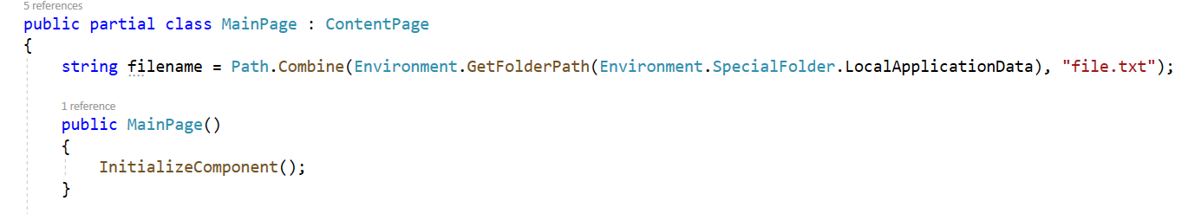
How to use Text File in your application
First Specify the path of the file in MainPage Class

Slide 6
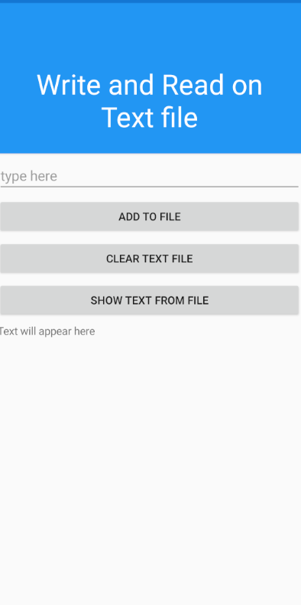
Lets make this application to read and write on Text file

Slide 7
Prepare your XAML Main page
<StackLayout>
<Frame BackgroundColor="#2196F3" Padding="24" CornerRadius="0">
<Label Text="Write and Read on Text file" HorizontalTextAlignment="Center" TextColor="White" FontSize="36"/>
</Frame>
<Entry Placeholder="type here" x:Name="txtfile"/>
<Button Text="Add to File" x:Name="btnFile" Clicked="btnFile_Clicked"/>
<Button Text="Clear Text file" x:Name="btnClear" Clicked="btnClear_Clicked"/>
<Button Text="Show text from File" x:Name="btnRead" Clicked="btnRead_Clicked"/>
<Label x:Name="fileView" Text="Text will appear here"/>
</StackLayout>

Slide 8
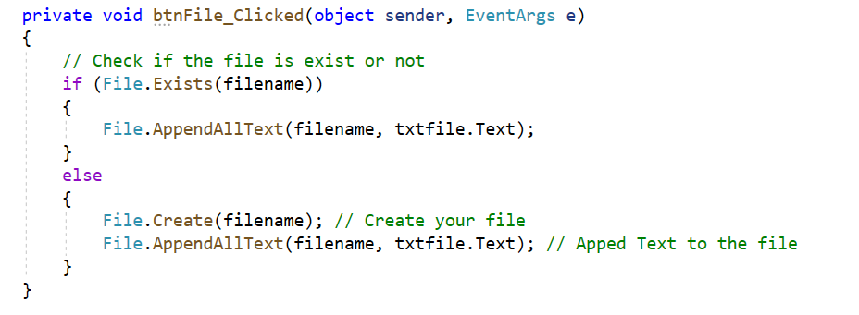
Write Your Button code

Slide 9
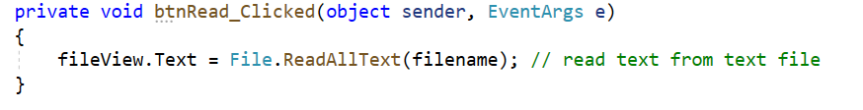
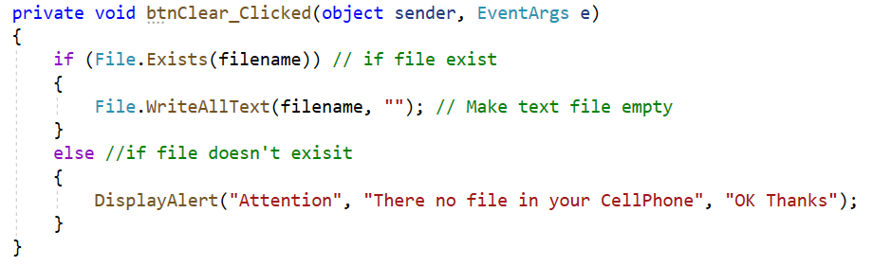
Form More Inform about Handling file go to bellow link
File Handling in Xamarin.Forms - Xamarin | Microsoft Docs

Slide 10
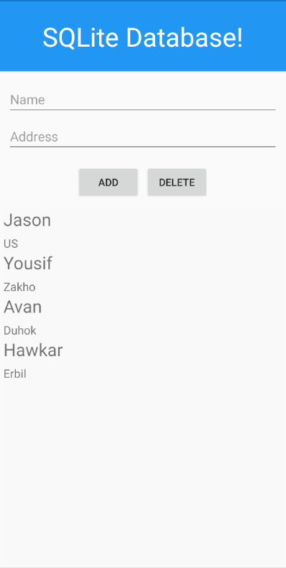
Let’s create an app and connect it with SQLite Database

Slide 11
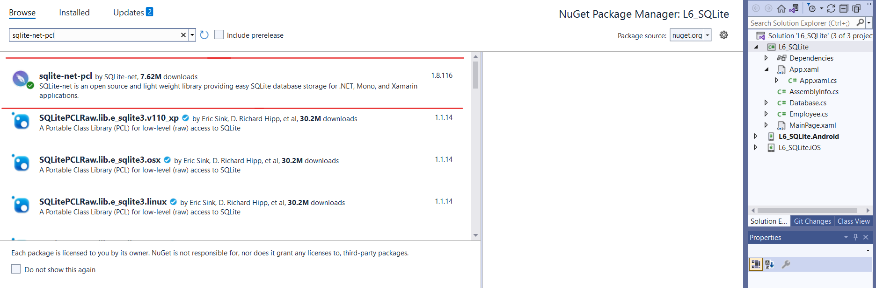
Add required library from Nuget Package Manager to your Xamarin Form App

Slide 12
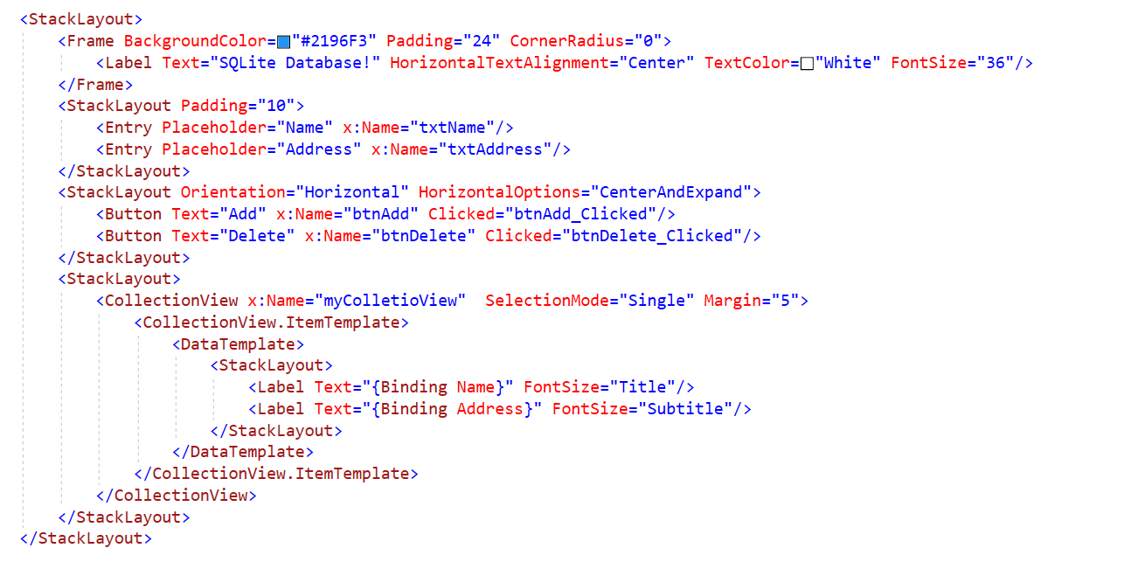
XAML page

Slide 13
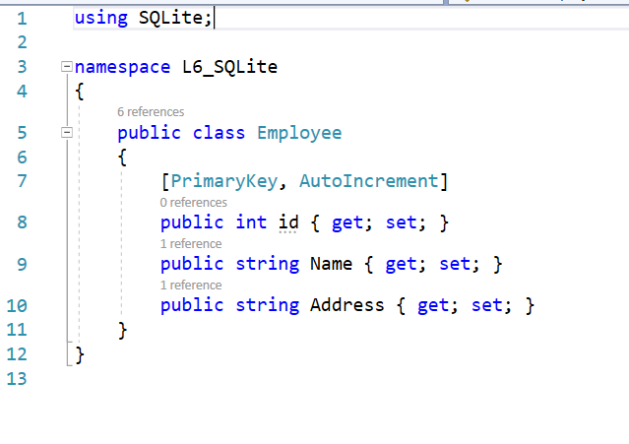
Create your model in your project

Slide 14
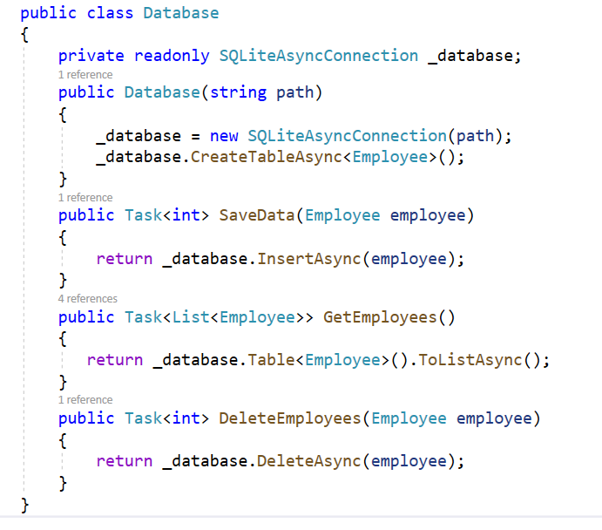
Create Database services Class

Slide 15
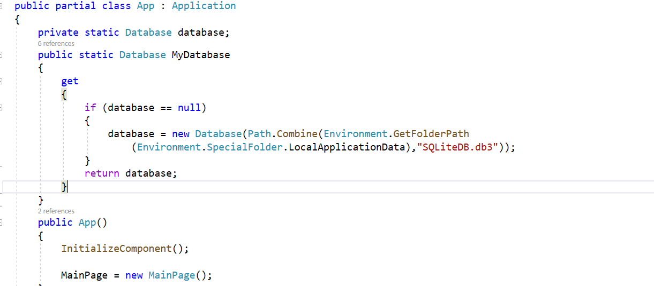
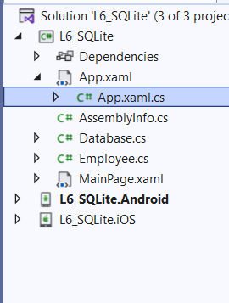
Add bellow code to App.xaml.cs file to create the database when first app loads

Slide 16
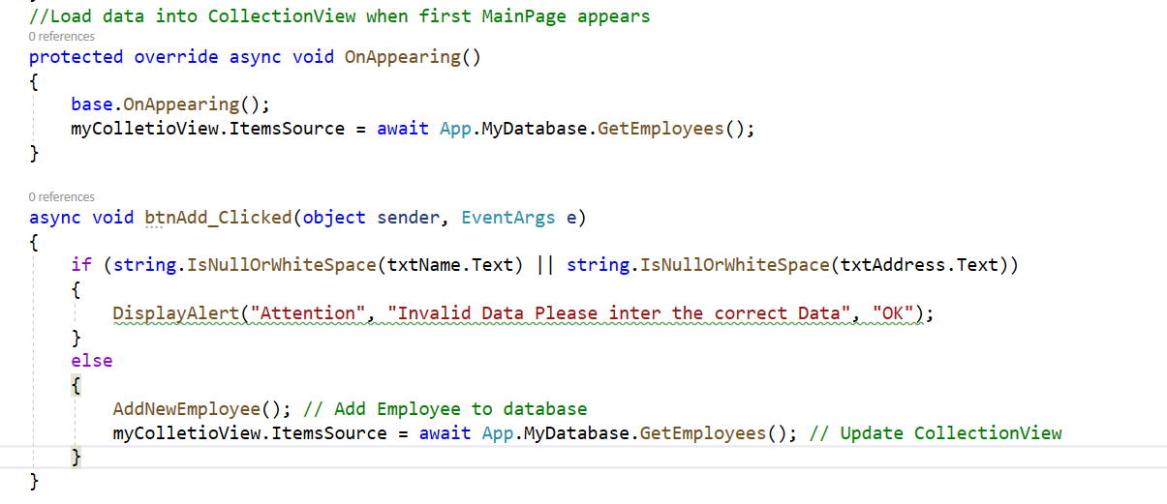
Write C# code in MainPage Class

Slide 17
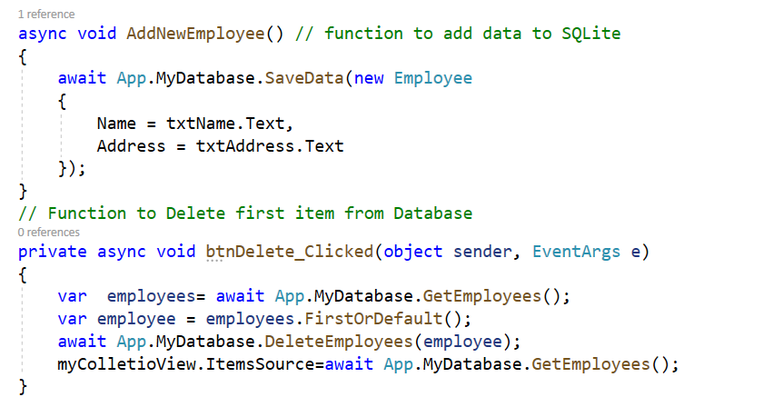
Fore more info about SQLite Database go to the bellow link Xamarin.Forms Local Databases - Xamarin | Microsoft Docs

Slide 18
Exercises
1- Create Fruit list in CollectionView.
2- Create Country list App in CollectionView and show Country Name, Capital with ability to Add, Edit, Update, Delete Items from CollectionView – Note: Use SQLite as your database to your data

Slide 19

Any Questions?

